Slide 1

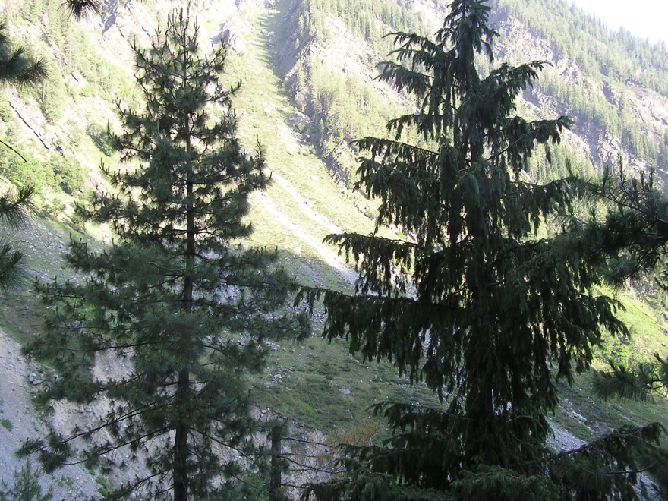
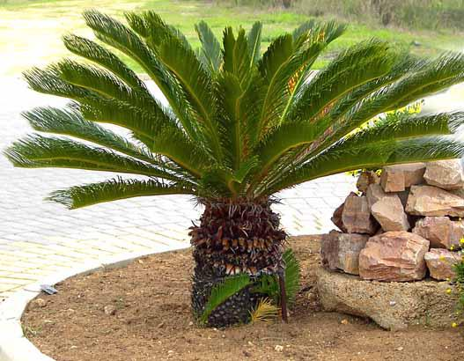
Gymnosperms
gymno– means naked
sperma– means seed
The plants of this group bear naked seeds and are usually perennial, evergreen and woody.
Examples are pine and deodar

Slide 2
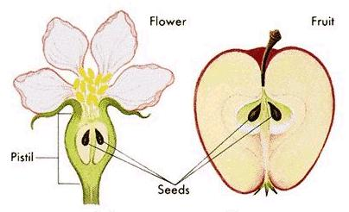
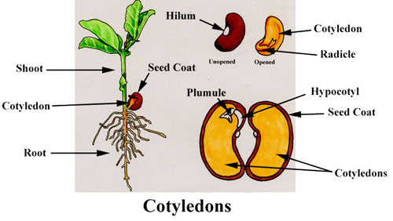
Angiosperms
angio – means covered
sperma– means seed
The seeds develop inside an organ which is modified to become a fruit. These are also called flowering plants.
Plant embryos in seeds have structures called cotyledons.
Cotyledons are called ‘seed leaves’ because in many instances they emerge and become green when the seed germinates.

Slide 3
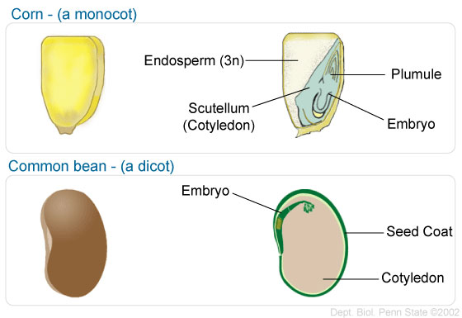
The angiosperms are divided into two groups on the basis of the number of cotyledons present in the seed.
Angiosperms
Monocotyledons
Dicotyledons
Plants with seeds having a single cotyledon are called monocotyledonous or monocots.
Plants with seeds having two cotyledons are called dicots.

